Slide 1
Lightweight Virtualization
LXC containers & AUFS
SCALE11x — February 2013, Los Angeles
Those slides are available at:
http://goo.gl/bFHSh

Slide 2
Outline
Intro: who, what, why?
LXC containers
Namespaces
Cgroups
AUFS
setns
Future developments

Slide 3

Who am I?
Jérôme Petazzoni
@jpetazzo
SRE (=DevOps) at dotCloud
dotCloud is the first "polyglot" PaaS,
and we built it with Linux Containers!

Slide 4
What is this about?
LXC (LinuX Containers) let you run a Linux system within another Linux system.
A container is a group of processes on a Linux box, put together in an isolated environment.
Inside the box, it looks like a VM.
Outside the box, it looks like normal processes.
This is "chroot() on steroids"
1. I will try to convince you that it's awesome.
2. I will try to explain how it works.
3. I will try to get you involved!

Slide 5
Why should I care?
1. I will try to convince you that it's awesome.
2. I will try to explain how it works.
3. I will try to get you involved!

Slide 6


Slide 7
Why should I care?
1. I will convince you that it's awesome.
2. I will explain how it works.
3. You will want to get involved!

Slide 8
Why is it awesome?
The 3 reasons why containers are awesome

Slide 9
Why?
3) Speed!
 | Ships within ... | Manual deployment takes ... | Automated deployment takes ... | Boots in ...
Bare Metal | days | hours | minutes | minutes
Virtualization | minutes | minutes | seconds | less than a minute
Lightweight Virtualization | seconds | minutes | seconds | seconds

Slide 10
Why?
2) Footprint!
On a typical physical server, with average compute resources, you can easily run:
10-100 virtual machines
100-1000 containers
On disk, containers can be very light.
A few MB — even without fancy storage.

Slide 11
Why?
1) It's still virtualization!
Each container has:
its own network interface (and IP address)
can be bridged, routed... just like $your_favorite_vm
its own filesystem
Debian host can run Fedora container (&vice-versa)
isolation (security)
container A & B can't harm (or even see) each other
isolation (resource usage)
soft & hard quotas for RAM, CPU, I/O...

Slide 12
Some use-cases
For developers,
hosting providers,
and the rest of us

Slide 13
Use-cases:
Developers
Continuous Integration
After each commit, run 100 tests in 100 VMs
Escape dependency hell
Build (and/or run) in a controlled environment
Put everything in a VM
Even the tiny things

Slide 14
Use-cases:
Hosters
Cheap Cheaper Hosting (VPS providers)
I'd rather say "less expensive", if you get my drift
Already a lot of vserver/openvz/... around
Give away more free stuff
"Pay for your production, get your staging for free!"
We do that at dotCloud
Spin down to save resources
And spin up on demand, in seconds
We do that, too

Slide 15
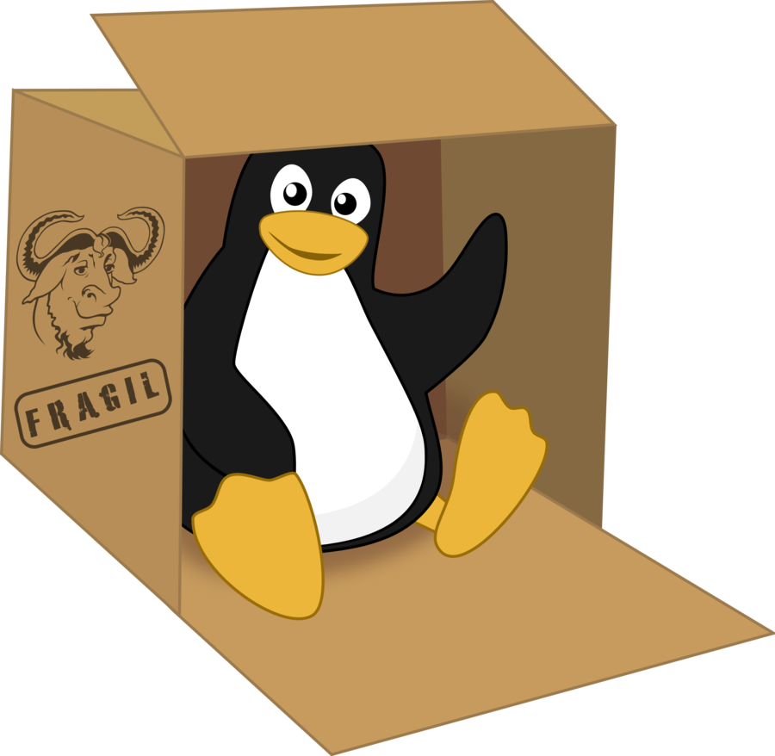
Use-cases:
Everyone
Look inside your VMs
You can see (and kill) individual processes
You can browse (and change) the filesystem
Do whatever you did with VMs
... But faster

Slide 16
Breaking news:
LXC can haz migration!
This slide intentionally left blank
(but the talk right before mine
should have interesting results)
oh yes indeed!

Slide 17
LXC lifecycle
lxc-createSetup a container (root filesystem and config)
lxc-startBoot the container (by default, you get a console)
lxc-console Attach a console (if you started in background)
lxc-stop Shutdown the container
lxc-destroy Destroy the filesystem created with lxc-create

Slide 18
How does it work?
First time I tried LXC:
# lxc-start --name thingy --daemon
# ls /cgroup
... thingy/ ...
"So, LXC containers are powered by cgroups?"
Wrong.

Slide 19
Namespaces
Partition essential kernel structures
to create virtual environments
e.g., you can have multiple processes
with PID 42, in different environments

Slide 20
Different kinds of namespaces
pid (processes)
net (network interfaces, routing...)
ipc (System V IPC)
mnt (mount points, filesystems)
uts (hostname)
user (UIDs)

Slide 21
Creating namespaces
Extra flags to the clone() system call
CLI tool unshare
Notes:
You don't have to use all namespaces
A new process inherits its parent's ns
No easy way to attach to an existing ns
Until recently! More on this later.

Slide 22
Namespaces: pid
Processes in a pid don't see processes of the whole system
Each pid namespace has a PID #1
pid namespaces are actually nested
A given process can have multiple PIDs
One in each namespace it belongs to
... So you can easily access processes of children ns
Can't see/affect processes in parent/sibling ns

Slide 23
Namespaces: net
Each net namespace has its own…
Network interfaces (and its own lo/127.0.0.1)
IP address(es)
routing table(s)
iptables rules
Communication between containers:
UNIX domain sockets (=on the filesystem)
Pairs of veth interfaces

Slide 24
Setting up veth interfaces
1/2
# Create new process, <PID>, with its own net ns
unshare --net bash
echo $$
# Create a pair of (connected) veth interfaces
ip link add name lehost type veth peer name leguest
# Put one of them in the new net ns
ip link set leguest netns <PID>

Slide 25
Setting up veth interfaces
2/2
# In the guest (our unshared bash), setup leguest
ip link set leguest name eth0
ifconfig eth0 192.168.1.2
ifconfig lo 127.0.0.1
# In the host (our initial environment), setup lehost
ifconfig lehost 192.168.1.1
# Alternatively:
brctl addif br0 lehost
# ... Or anything else!

Slide 26
Namespaces: ipc
Remember "System V IPC"?msgget, semget, shmget
Have been (mostly) superseded by POSIX alternatives: mq_open, sem_open, shm_open
However, some stuff still uses "legacy" IPC.
Most notable example: PostgreSQL
The problem: xxxget() asks for a key, usually derived from the inode of a well-known file
The solution: ipc namespace

Slide 27
Namespaces: mnt
Deluxe chroot()
A mnt namespace can have its own rootfs
Filesystems mounted in a mnt namespace are visible only in this namespace
You need to remount special filesystems, e.g.:
procfs (to see your processes)
devpts (to see your pseudo-terminals)

Slide 28
Setting up space efficient containers (1/2)
/containers/leguest_1/rootfs (empty directory)
/containers/leguest_1/home (container private data)
/images/ubuntu-rootfs (created by debootstrap)
CONTAINER=/containers/leguest_1
mount --bind /images/ubuntu-rootfs $CONTAINER/rootfs
mount -o ro,remount,bind /images/ubuntu-rootfs $CONTAINER/rootfs
unshare --mount bash
mount --bind $CONTAINER/home $CONTAINER/rootfs/home
mount -t tmpfs none $CONTAINER/tmp
# unmount what you don't need ...
# remount /proc, /dev/pts, etc., and then:
chroot $CONTAINER/rootfs

Slide 29
Setting up space efficient containers (2/2)
Repeat the previous slides multiple times (Once for each different container.)
But, the root filesystem is read-only...?
No problem, nfsroot howtos have been around since … 1996

Slide 30
Namespaces: uts
Deals with just two syscalls:
gethostname(),sethostname()
Useful to find out in which container you are
... More seriously: some tools might behave differently depending on the hostname (sudo)

Slide 31
Namespaces: user
UID42 in container X isn't UID42 in container Y
Useful if you don't use the pid namespace (With it, X42 can't see/touch Y42 anyway)
Can make sense for system-wide, per-user resource limits if you don't use cgroups
Honest: didn't really play with those!

Slide 32
Control Groups
Create as many cgroups as you like.
Put processes within cgroups.
Limit, account, and isolate resource usage.
Think ulimit, but for groups of processes
… and with fine-grained accounting.

Slide 33
Cgroups: the basics
Everything exposed through a virtual filesystem
/cgroup, /sys/fs/cgroup... YourMountpointMayVary
Create a cgroup:
mkdir /cgroup/aloha
Move process with PID 1234 to the cgroup:
echo 1234 > /cgroup/aloha/tasks
Limit memory usage:
echo 10000000 > /cgroup/aloha/memory.limit_in_bytes

Slide 34
Cgroup: memory
Limit
memory usage, swap usage
soft limits and hard limits
can be nested
Account
cache vs. rss
active vs. inactive
file-backed pages vs. anonymous pages
page-in/page-out
Isolate
"Get Off My Ram!"
Reserve memory thanks to hard limits

Slide 35
Cgroup: CPU (and friends)
Limit
Set cpu.shares (defines relative weights)
Account
Check cpustat.usage for user/system breakdown
Isolate
Use cpuset.cpus (also for NUMA systems)
Can't really throttle a group of process.
But that's OK: context-switching << 1/HZ

Slide 36
Cgroup: Block I/O
Limit & Isolate
blkio.throttle.{read,write}.{iops,bps}.device
Drawback: only for sync I/O (i.e.: "classical" reads; not writes; not mapped files)
Account
Number of IOs, bytes, service time...
Drawback: same as previously
Cgroups aren't perfect if you want to limit I/O.
Limiting the amount of dirty memory helps a bit.

Slide 37
AUFS
Writable single-system images
or
Copy-on-write at the filesystem level

Slide 38
AUFS quick example
You have the following directories:
/images/ubuntu-rootfs
/containers/leguest/rootfs
/containers/leguest/rw
mount -t aufs \ -o br=/containers/leguest/rw=rw:/images/ubuntu-rootfs=ro \ none /containers/leguest/rootfs
Now, you can write in rootfs: changes will go to the rw directory.

Slide 39
Union filesystems benefits
Use a single image (remember the mnt namespace with read-only filesystem?)
Get read-writable root filesystem anyway
Be nice with your page cache
Easily track changes (rw directory)

Slide 40
AUFS layers
Traditional use
one read-only layer, one read-write layer
System image development
one read-only layer, one read-write layer
checkpoint current work by adding another rw layer
merge multiple rw layers (or use them as-is)
track changes and replicate quickly
Installation of optional packages
one read-only layer with the base image
multiple read-only layers with "plugins" / "addons"
one read-write layer (if needed)

Slide 41
AUFS compared to others
Low number of developers
Not in mainstream kernel
But Ubuntu ships with AUFS
Has layers, whiteouts, inode translation, proper support for mmap...
Every now and then, another Union FS makes it into the kernel (latest is overlayfs)
Eventually, (some) people realize that it lacks critical features (for their use-case)
And they go back to AUFS

Slide 42
AUFS personal statement
AUFS is the worst union filesystems out there;
except for all the others that have been tried.
Not Churchill

Slide 43
Getting rid of AUFS
Use separate mounts for tmp, var, data...
Use read-only root filesystem
Or use a simpler union FS (important data is in other mounts anyway)

Slide 44
setns()
The use-case
Use-case: managing running containers
(i.e. "I want to log into this container")
SSH (inject authorized_keys file)
some kind of backdoor
spawn a process directly in the container
This is what we want!
no extra process (it could die, locking us out)
no overhead

Slide 45
setns()
In theory
LXC userland tools feature lxc-attach
It relies on setns() syscall…
…And on some files in /proc/<PID>/ns/
fd = open("/proc/<pid>/ns/pid")
setns(fd, 0)
And boom, the current process joined the namespace of <pid>!

Slide 46
setns()
In practice
Problem (with kernel <3.8):
# ls /proc/1/ns/
ipc net uts
Wait, what?!? (We're missing mnt pid user)
You need custom kernel patches.
Linux 3.8 to the rescue!

Slide 47
Lightweight virtualization at dotCloud
>100 LXC hosts
Up to 1000 running containers per host
Many more sleeping containers
Webapps
Java, Python, Node.js, Ruby, Perl, PHP...
Databases
MySQL, PostgreSQL, MongoDB...
Others
Redis, ElasticSearch, SOLR...

Slide 48
Lightweight virtualization at $HOME
We wrote the first lines of our current container management code back in 2010
We learned many lessons in the process (sometimes the hard way!)
It got very entangled with our platform (networking, monitoring, orchestration...)
We are writing a new container management tool, for a DevOps audience
Would you like to know more?

Slide 49
Mandatory shameless plug
If you think that this was easy-peasy,
or extremely interesting:
Join us!
jobs@dotcloud.com

Slide 50

Thank you!
More about containers, scalability, PaaS...
http://blog.dotcloud.com/
@jpetazzo

Slide 51

Thank you!
More about containers, scalability, PaaS...
http://blog.dotcloud.com/
@jpetazzo

